Slide 1
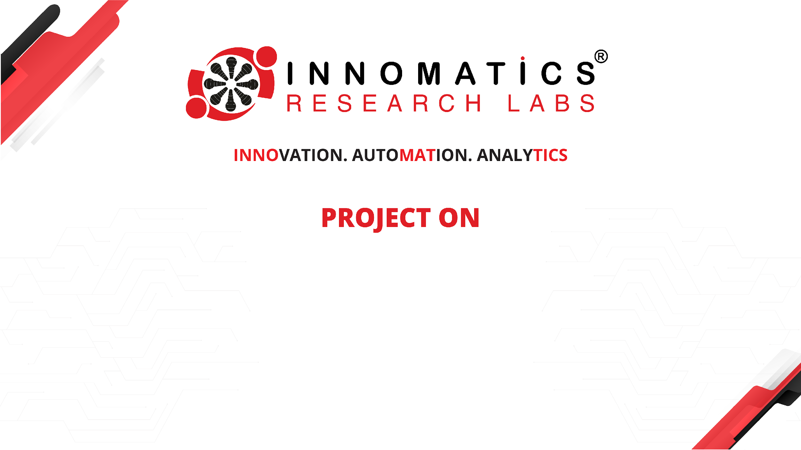
Code Refactoring and Bug Fixing

Slide 2
About me
I am an emerging data scientist who recently competed his Masters in Computer Applications with Specialization in Machine Learning. My educational has always been quite average but I think I possess a quality much needed for a Data Science career which is ability to learn quickly and curiosity. I like to work in my comfort zone but more often than not, I like to challenge myself with tasks that seems to be quite interesting.
I want to learn andd excel in Data Science because of mostly two reasons. First, the field of data science has its connections and usability in almost every field out there and secondly it aligns with my dream of using my skills to work in an automotive company like Koenigsegg where they do use engineering to design world’s fastest cars but also rely on massive amonts of data to make that possible. I want to be the one to dive and get insights from that data and also build complex models that can eliminate the use to drivers in a car to such an extent where it would seem like a norm to have a driverless vehicle and experience that same thrill while riding in the passenger seat.
I have 7 months experince as a Subject Matter Expert (SME) at hexaware technologies where I worked in conjunction with the Analytical team by providing them business information to develop models and drive insights from data to improve the business process and solve real world scenarios of customer problems.
Link to Github Repository : LINK

Slide 3
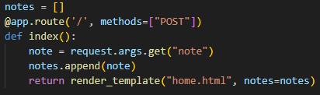
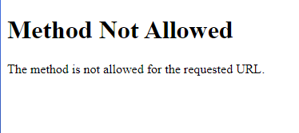
Task Refactor the existing codebase and ensure the proper functioning of the Note Taking Application. Document all identified bugs during the debugging process.
Debugging
Debugging is the process of identifying and fixing errors, or bugs, in software code. It is an essential skill for software developers and involves systematically locating and resolving issues that prevent the code from functioning correctly.
Debugging is an iterative and systematic process that requires patience, attention to detail, and problem-solving skills. By employing a combination of techniques and strategies, developers can effectively identify and resolve bugs, leading to more robust and reliable software.
First we shall look at the provided Python code then we shall move on to the HTML code.
Bugs in th Python code and their fixes
Detected an error in the method provided for the ‘/’ route ->
PROBLEM : The method provided for this route is only ‘POST’ which is a method that is used to submit data to be processed to a specified resource. It sends data in the request body and is commonly used for creating or updating resources on the server. When running the application, the type of request being sent to the route is “GET” but the route currently is only capable of listening to “POST” requests.

Slide 4
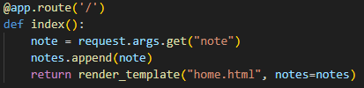

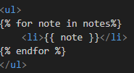
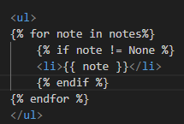



Fix : Since this route is not only adding data to the notes list but also displaying that data on the web page, we shall remove the ‘methods’ parameter and set it back to default which is ‘GET’.
Detected an error in the HTML code
Problem : The codebase provided was displaying ‘None’ as an item of the list.
Fix : Using Jinja templating in the HTML code, added a condition that the notes list will only be displayed if the list item is not equal to None i.e. list should not be empty.
Detected an error in the HTML code
Problem : The form tag in the HTML code was not having a “Submit” button to submit details from the client to the server.
Fix: Added the “Submit” button.
Quality of Life Change -> The title of the page was “Document”. ,
Changed that to “Note Taking APP”.

Slide 5

THANK YOU

